Slide 1
TypeScript JavaScript + NXT
@basarat
Google it

Slide 2
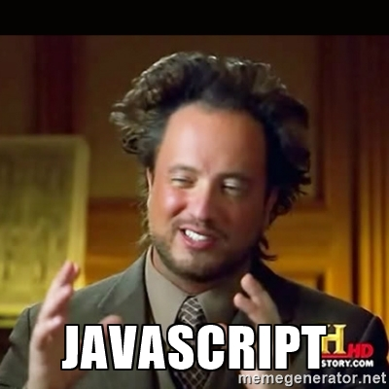

Slide 3
LESS WAT

Slide 4
WAT

Slide 5
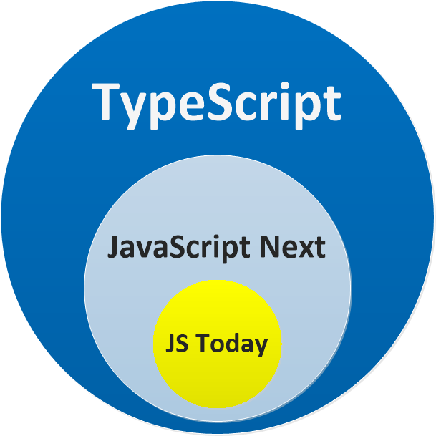

Slide 6
DEMO
Just a JS file
A JS Project

Slide 8


Slide 9


Slide 12
QUESTIONS

Slide 13


alm.tools
Google:
TypeScript Book

Slide 14
@basarat

